Slide 1
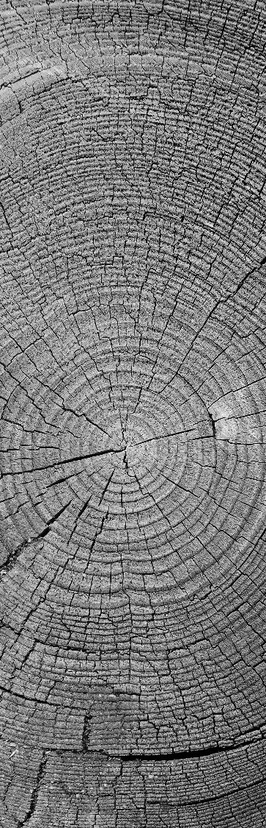
Methods in digital IMAGE steganography
CSE/ECE 478 Digital Image Processing Project
By
Kiruthika Kannan - 2018702001
Ritu Srivatsava - 2018701002

Slide 2

Project Details
Project Id | 13
Title | Methods in digital steganography
Team Members | Kiruthika Kannan | 2018702001 | kiruthika.k@research.iiit.ac.in
 | Ritu Srivatsava | 2018701002 | ritu.srivatsava@research.iiit.ac.in
Github Link | https://github.com/kiruthika-kannan/Steganography.git
Images Link | https://drive.google.com/drive/folders/14_Tj1dO9YJemFGazQpYjIqfVLT7mSPp6

Slide 3
IMAGE STEGANOGRAPHY
What is steganography?
Steganography is the science that involves communicating secret data in an appropriate Multimedia carrier, e.g., image, audio, and video files.
What has to be done?
It comes under the assumption that if the feature is visible, the point of attack is evident, thus the goal here is always to conceal the very existence of the embedded data.
Why steganography?
The advantage of steganography over cryptography alone is that the intended secret message does not attract attention to itself as an object of scrutiny.

Slide 4

Problem definition
To efficiently conceal an secret image in an image such that the hidden image in the stego-image is imperceptible to human vision system.
To extract the hidden image from the stego-image

Slide 5
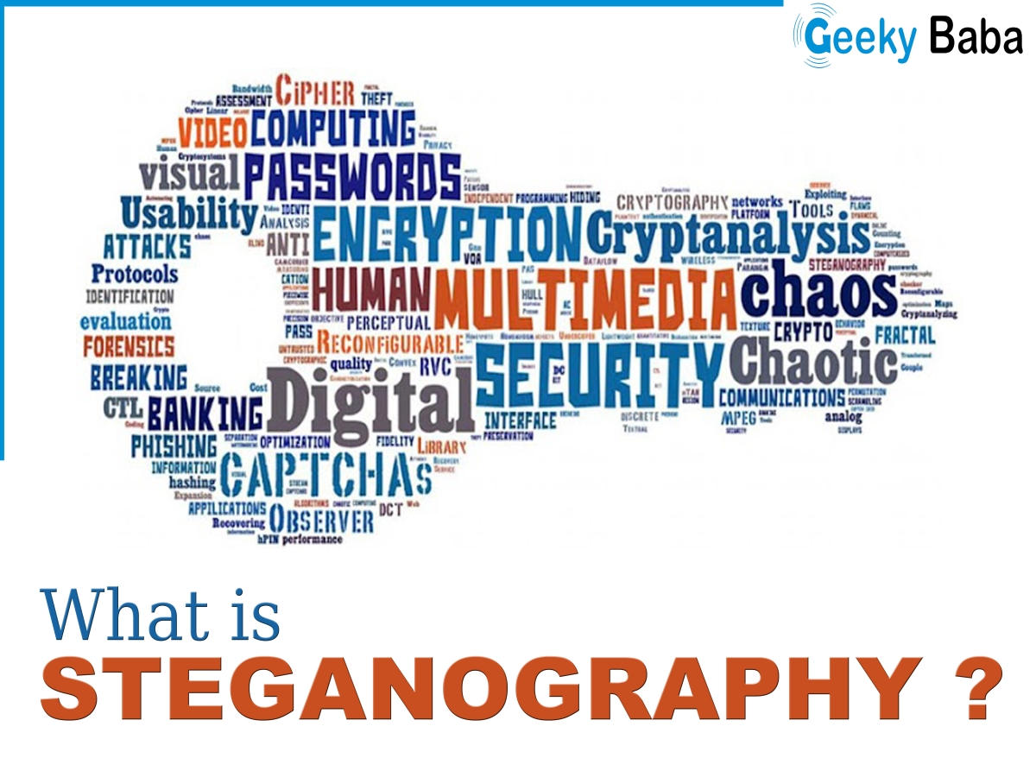
Main goals of the project
Exploring
Implementing
Evaluating
different methods of digital image steganography.
The primary goal of each method is to maximize the amount of information hidden while keeping the noticeable difference to a minimum

Slide 6
Overview of digital image steganography
Cover Image
EMBEDDING PROCESS
Stego Image
Payload Image
Communication channel
Extracted Cover Image
Stego Image
EXTRACTION PROCESS
Extracted Payload Image

Slide 7
Content
Least Significant Bit (LSB) substitution
Edge image based steganography
Bit plane complexity based steganography
Pixel Value Differencing (PVD) based steganography
Exploiting Modification Direction (EMD)
Sparse pixels from histogram and Euclidean distance Measure in spatial domain
Discrete Cosine Transform

Slide 8
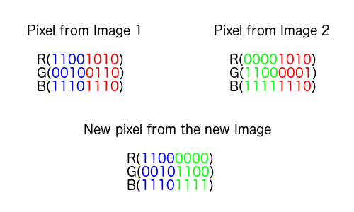
Least Significant Bit (LSB) substitution
Cover Image
Payload Image
(8-n) Most Significant Bits
n Least Significant Bits
Stego Image
(8-n) Most Significant Bits
n Least Significant Bits
Extracted Cover Image
Extracted Payload Image

Slide 9
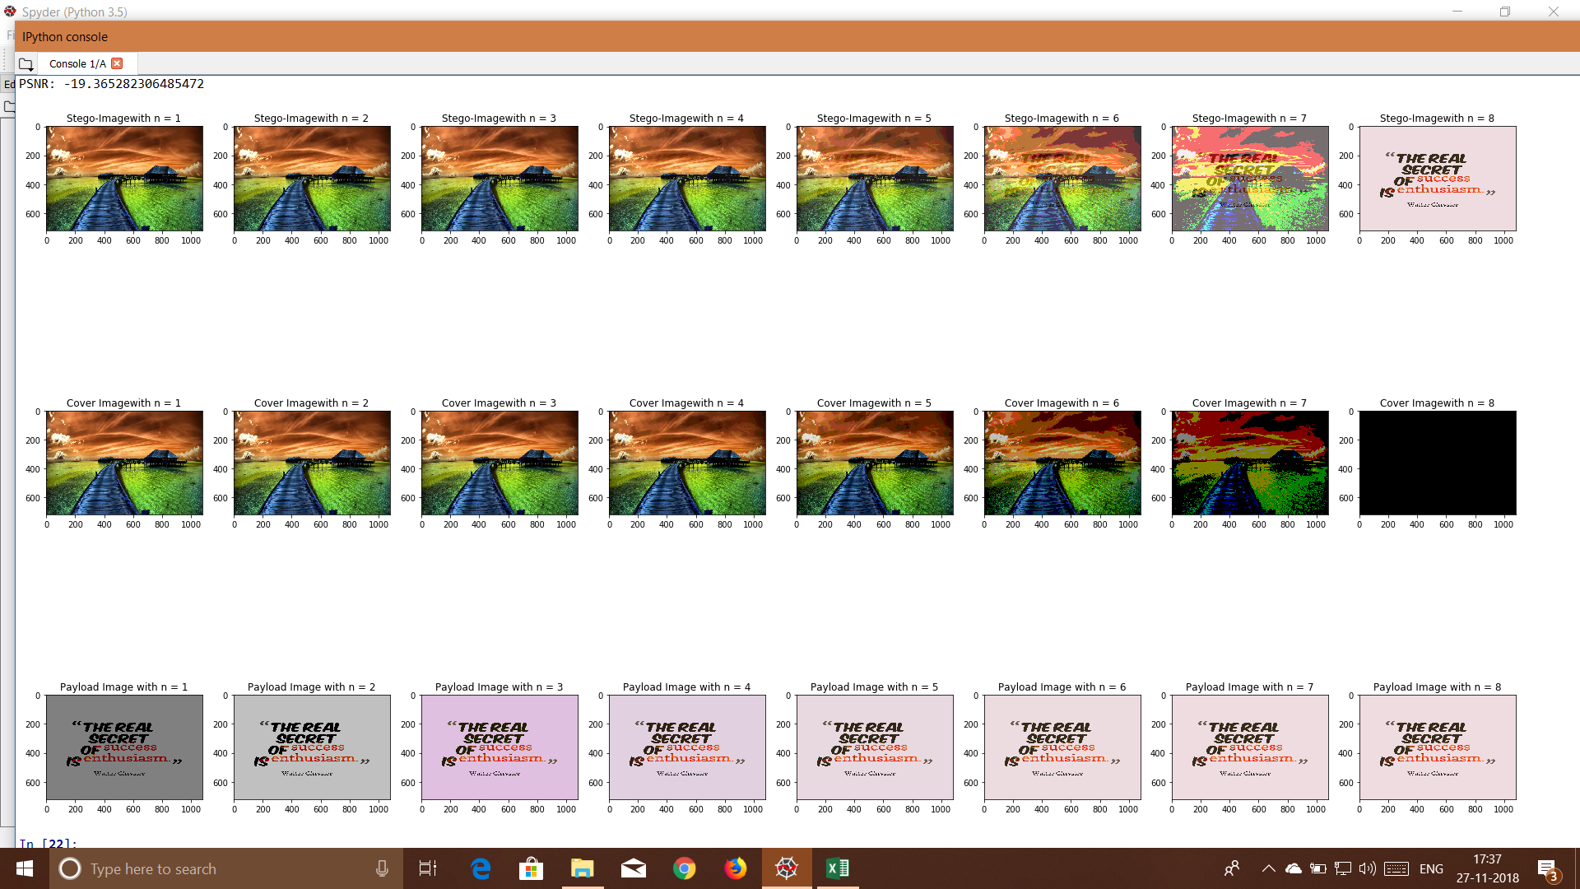
Least Significant Bit (LSB) substitution

Slide 10
Least Significant Bit (LSB) substitution
LSB substitution is the simplest method.
But it does not take into account the characteristics of cover or payload image.
Both embedding and extraction algorithms must know the value of n.
Increasing the number of bits n increases the embedding capacity but decreases the visual quality of stego-image.
No. of replace bits | PSNR | MSE
1 | 48.46307 | 0.926346
2 | 38.92418 | 8.330334
3 | 31.96084 | 41.39963
4 | 25.73665 | 173.5462
5 | 28.26059 | 97.05584
6 | 26.7174 | 138.4652
7 | 30.3865 | 59.48816

Slide 11

Content
Least Significant Bit (LSB) substitution
Edge image based steganography
Bit plane complexity based steganography
Pixel Value Differencing (PVD) based steganography
Exploiting Modification Direction (EMD)
Sparse pixels from histogram and Euclidean distance Measure in spatial domain
Discrete Cosine Transform

Slide 12
Edge image based steganography
Cover Image
Edge Image
Payload Image
Stego Image
No. of replace bits m
Embedding status data
m Most Significant Bits
(8-m) Least Significant Bits
(8-m) Least Significant Bits
m Most Significant Bits
No. of replace bits m
Embedding status data
Extracted Cover Image
Extracted Payload Image
Stego Image

Slide 13
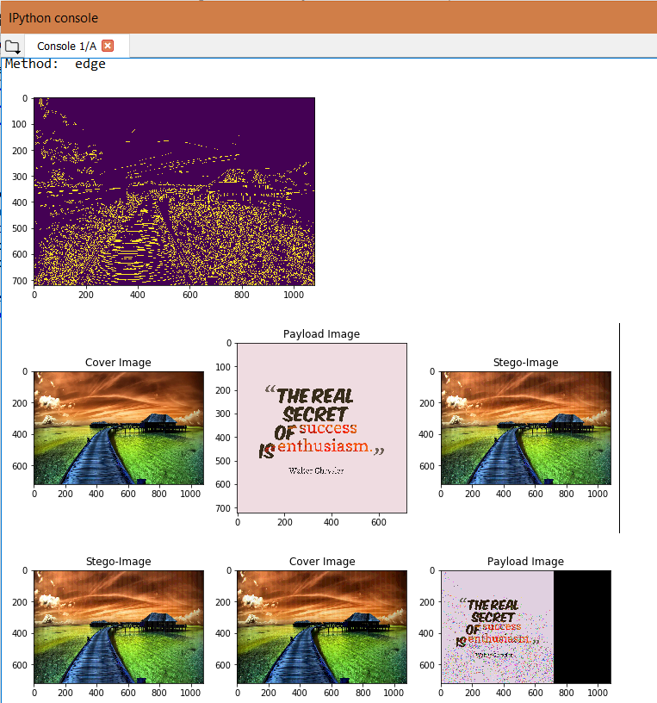
Edge image based steganography
Edge pixels can be embedded with more bits of information. This method exploits this property.
Embedding status bits causes an overhead reducing the size of payload that can be embedded.
This method gave an average PSNR of 44.803 and MSE of 5.14

Slide 14
Content
Least Significant Bit (LSB) substitution
Edge image based steganography
Bit plane complexity based steganography
Pixel Value Differencing (PVD) based steganography
Exploiting Modification Direction (EMD)
Sparse pixels from histogram and Euclidean distance Measure in spatial domain
Discrete Cosine Transform

Slide 15
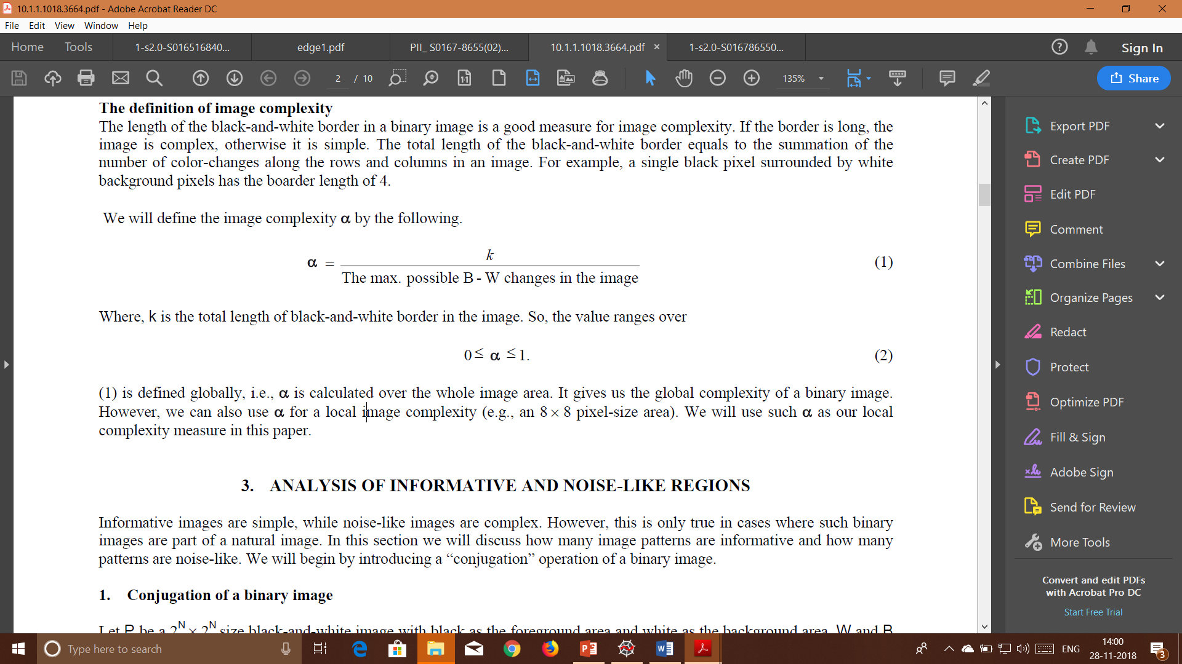
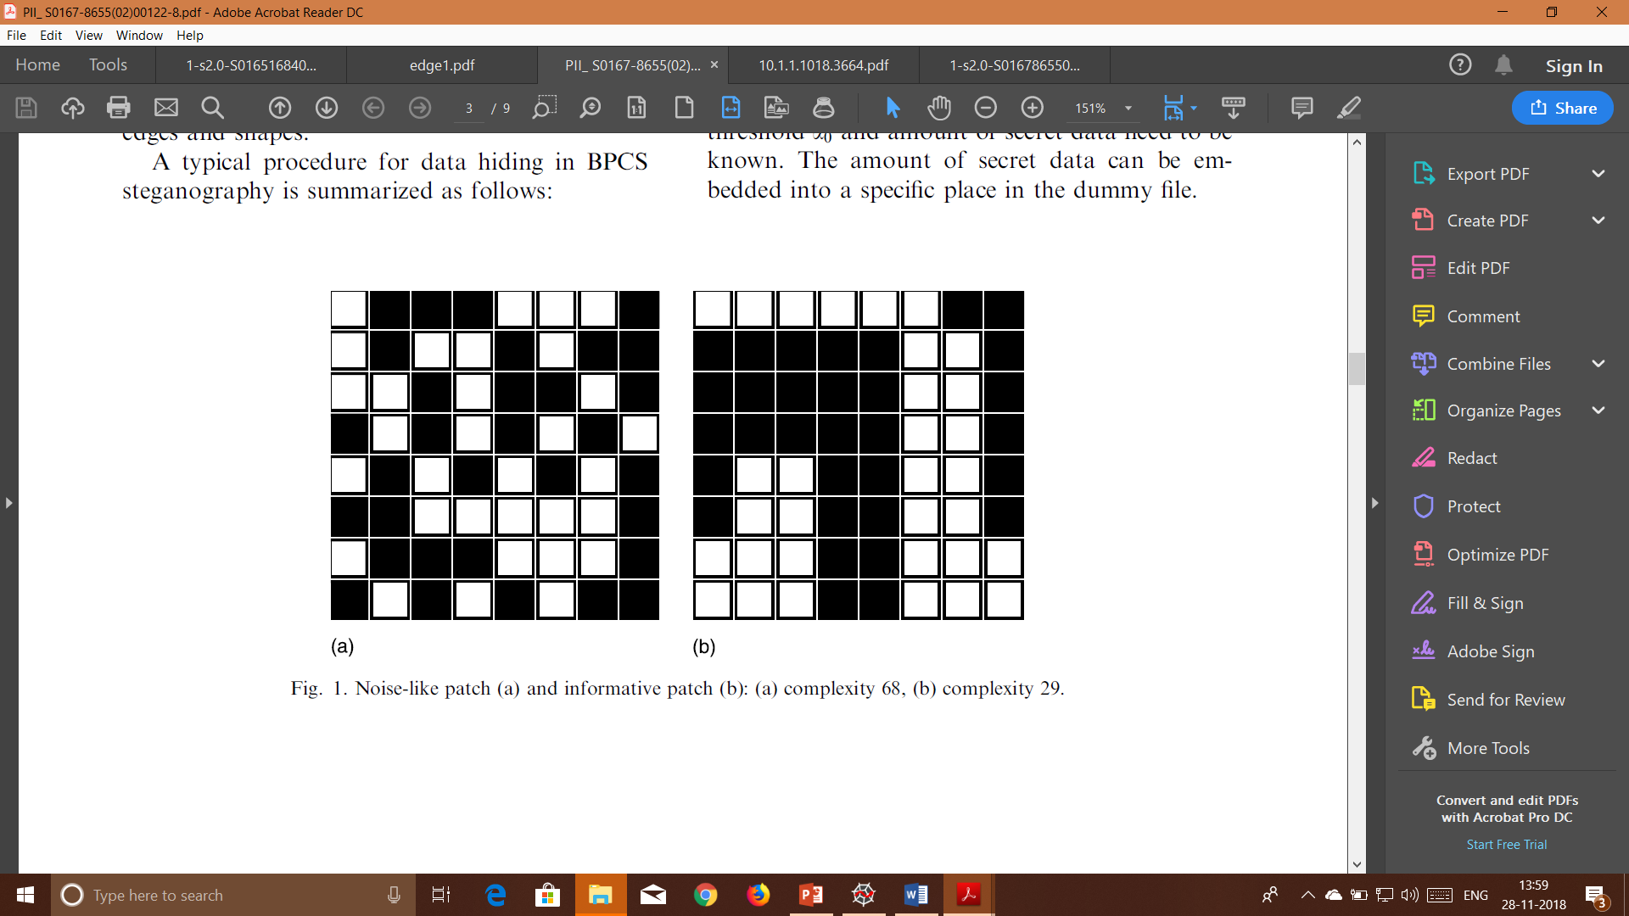
Bit plane complexity

Slide 16
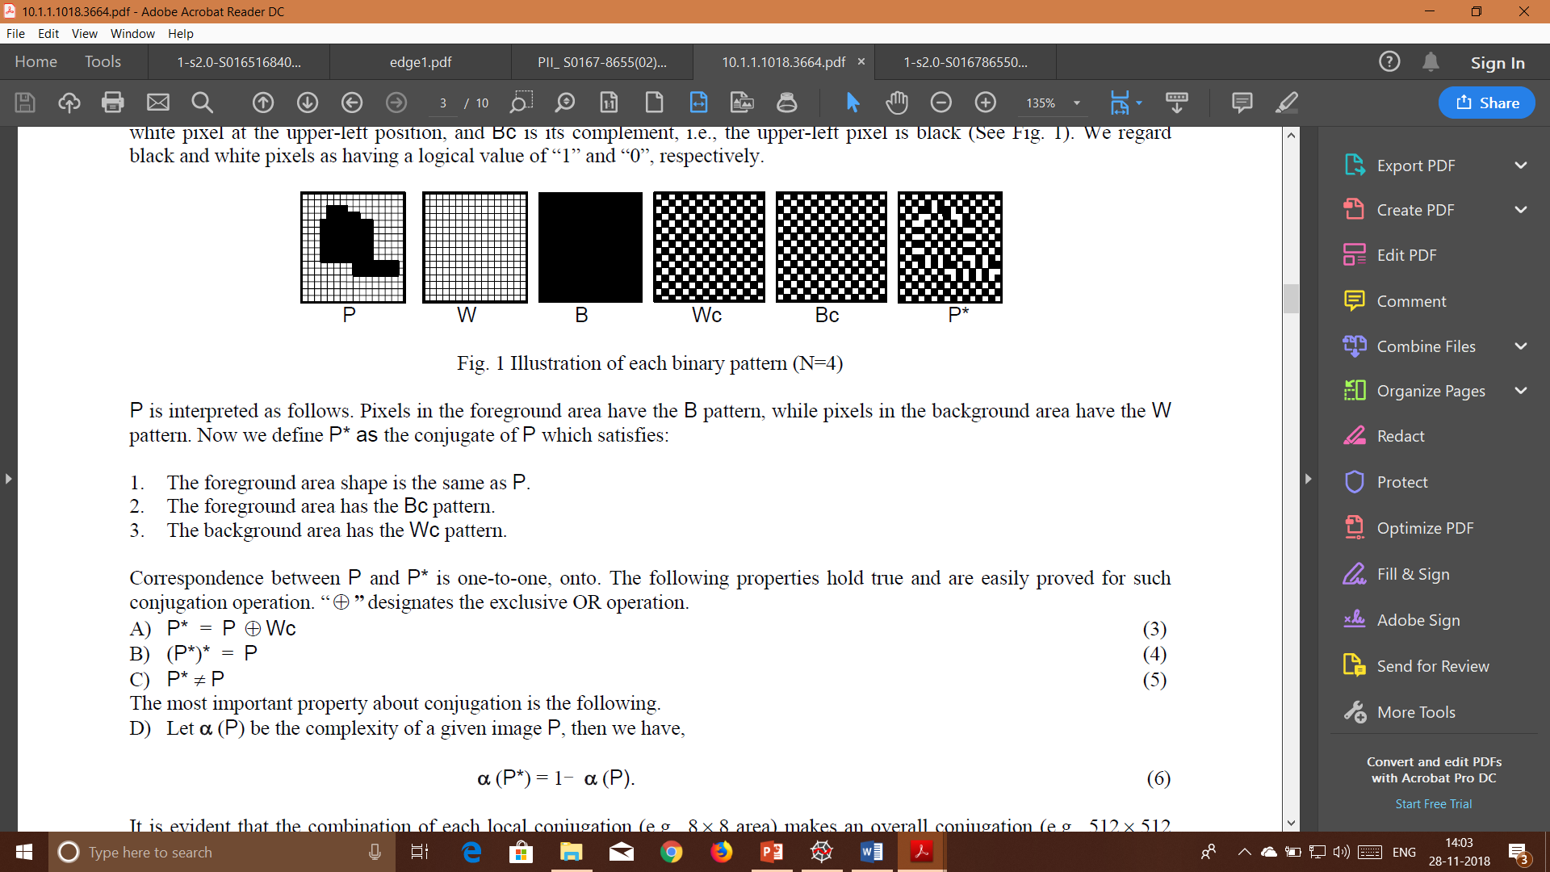
Bit plane complexity Conjugate

Slide 17
Bit plane complexity based steganography
Cover Image
Payload Image
Divide into nxn blocks
Divide into nxn blocks
Compute BPC of each bit plane
Compute BPC of each bit plane
Compute number of bits to replace ‘m’
If BPCS < threshold
Get (8-‘m’) most significant bits
Get ‘m’ least significant bits
Compute complexity conjugate of the plane
Compute conjugation map
Embed
Stego Image

Slide 18
Bit plane complexity based steganography
Stego Image
Compute conjugation map
Divide into nxn blocks
Compute BPC of each bit plane
Get (8-‘m’) least significant bits
Compute number of bits to replace ‘m’
Get ‘m’ most significant bits
Compute complexity conjugate of the plane
Cover Image
Payload Image

Slide 19
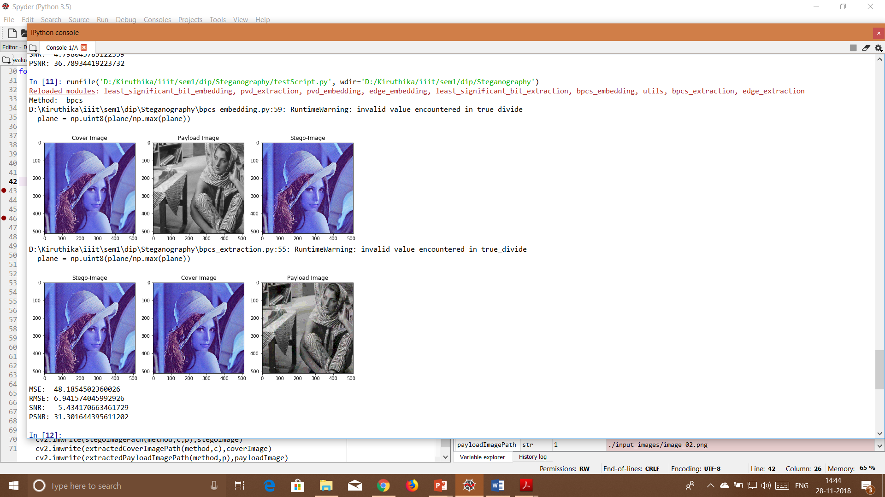
Bit plane complexity based steganography
Block complexity method relies solely on the complexity of the blocks estimated using the block edges. This does not guarantee the classification of noise and informative blocks.
Moreover the performance is affected by the block size.
This method gave an average PSNR of 30.68 and MSE of 60.40

Slide 20
Content
Least Significant Bit (LSB) substitution
Edge image based steganography
Bit plane complexity based steganography
Exploiting Modification Direction (EMD)
Sparse pixels from histogram and Euclidean distance Measure in spatial domain
Discrete Cosine Transform
Pixel Value Differencing (PVD) based steganography

Slide 21
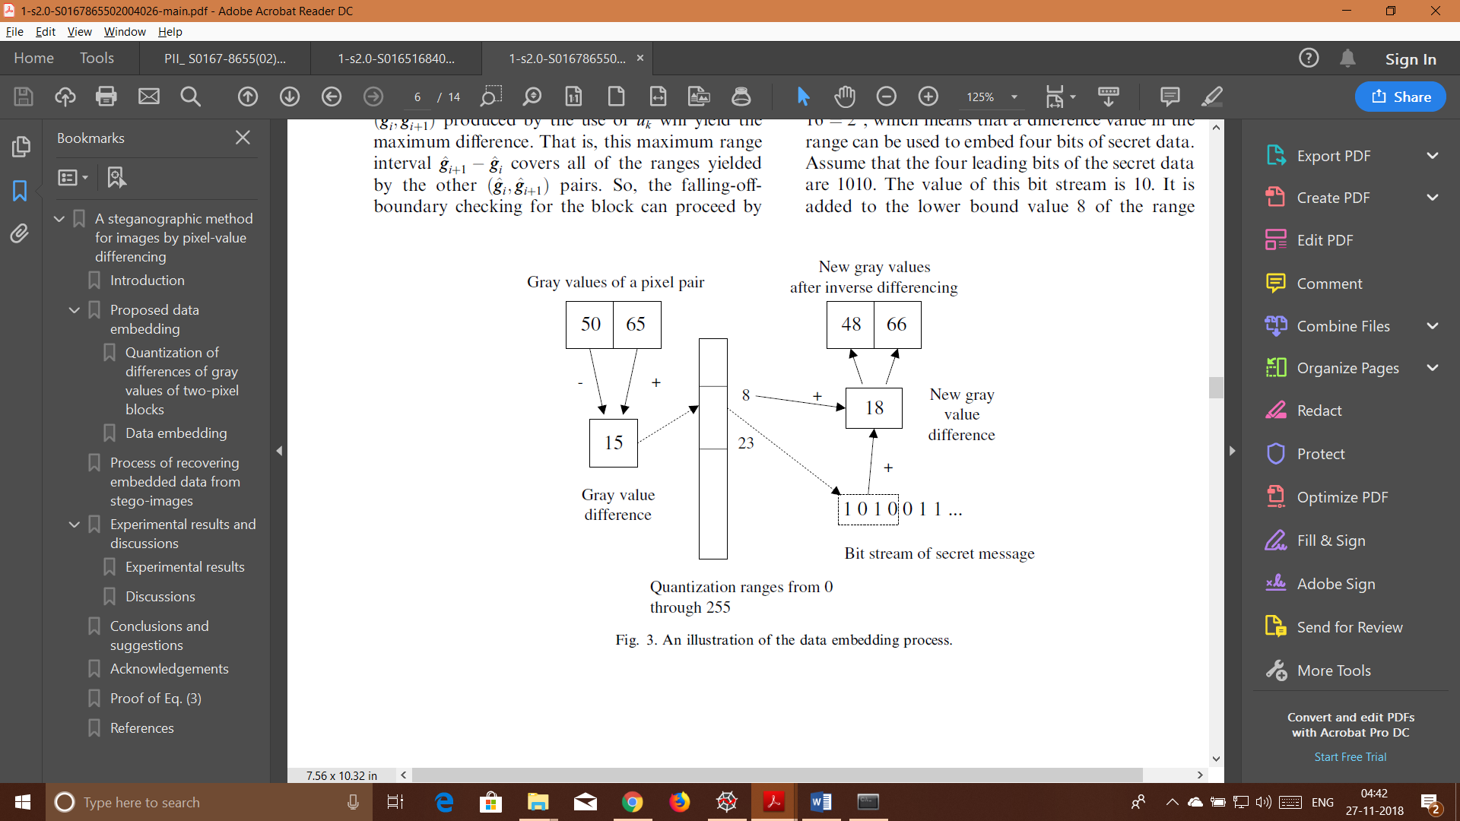
Pixel Value Differencing (PVD) based steganography
Difference Range | No of bits to be replaced
[0,7] | 3
[8,15] | 3
[16,31] | 4
[31,63] | 5
[64,127] | 6
[128,255] | 7

Slide 22
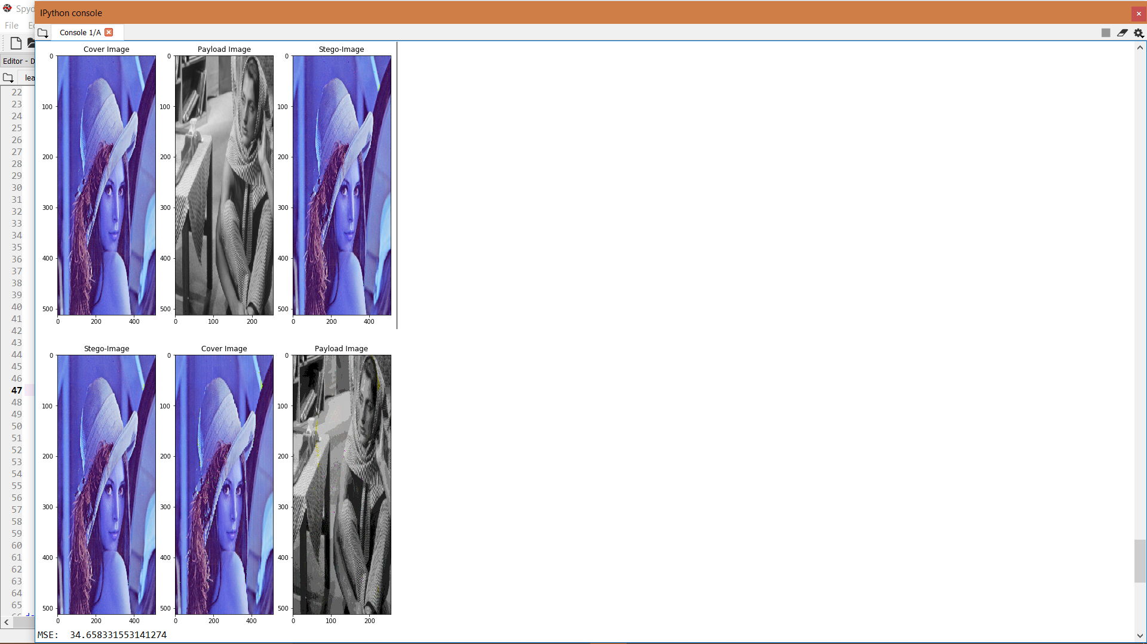
Pixel Value Differencing (PVD) based steganography
Works on the gradient rather than the image intensities
Gradient is large more bits are embedded
The embedding capacity is half the previous methods

Slide 23
Pixel Value Differencing (PVD) based steganography
Works on the gradient rather than the image intensities
Gradient is large more bits are embedded
The embedding capacity is half the previous methods

Slide 24
Content
Least Significant Bit (LSB) substitution
Edge image based steganography
Bit plane complexity based steganography
Pixel Value Differencing (PVD) based steganography
Exploiting Modification Direction (EMD)
Sparse pixels from histogram and Euclidean distance Measure in spatial domain
Discrete Cosine Transform

Slide 25
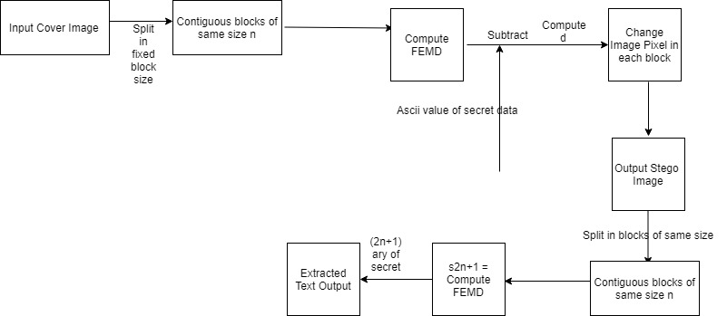
Exploiting Modification Direction (EMD)

Slide 26

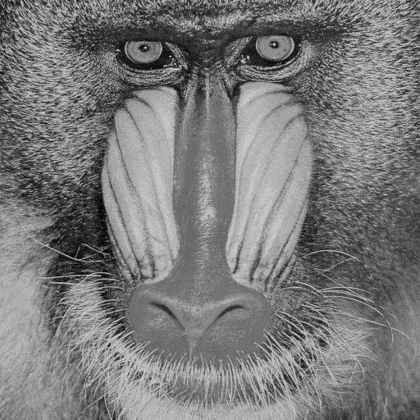
Exploiting Modification Direction (EMD)
Embedding capacity of EMD decreases fast as n increases (n- no of pixels in group)
Embedding capacity can be further improved by using Generalized EMD.
Our scheme maintains the good image quality and can resist the RS detection.
Cover image
Input Text : fly high
Stego-image

Slide 27
Content
Least Significant Bit (LSB) substitution
Edge image based steganography
Bit plane complexity based steganography
Exploiting Modification Direction (EMD)
Sparse pixels from histogram and Euclidean distance Measure in spatial domain
Discrete Cosine Transform
Pixel Value Differencing (PVD) based steganography

Slide 28
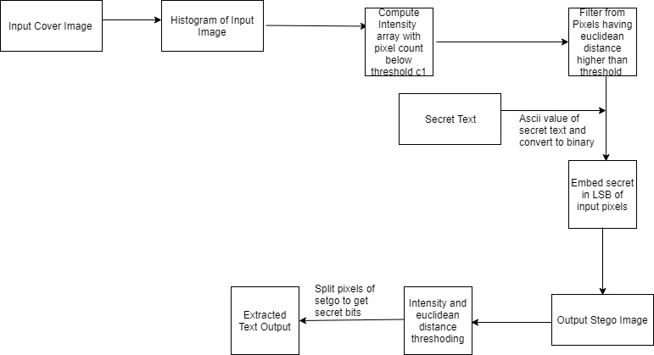
Sparse pixels from histogram and Euclidean distance Measure in spatial domain

Slide 29


Sparse pixels from histogram and Euclidean distance Measure in spatial domain
Embedding capacity is low since we are using sparse pixels based on euclidean distance. But visual quality of stego image is good.
cover-image
Stego-image
Input Text : conference

Slide 30
Content
Least Significant Bit (LSB) substitution
Edge image based steganography
Bit plane complexity based steganography
Pixel Value Differencing (PVD) based steganography
Exploiting Modification Direction (EMD)
Sparse pixels from histogram and Euclidean distance Measure in spatial domain
Discrete Cosine Transform

Slide 31
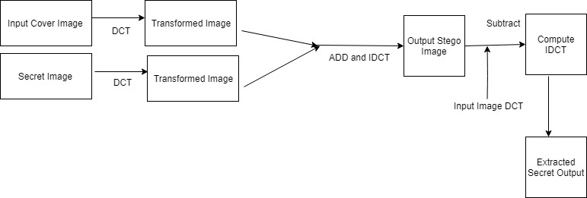
Discrete Cosine Transform

Slide 32



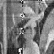
Discrete Cosine Transform
Payload/Secret Image requires original for recovery. Block wise recovery is tough after embedding secrets bits in frequency domain.
Since most of the signal information tends to be concentrated in a few low-frequency components of the DCT , high frequency components can be used for embedding.
Also Embedding capacity of high frequency coefficients is higher.
Cover image
Stego -image
payload
Extracted payload

Slide 33
Discrete Cosine Transform
Image | Weight | PSNR | MSE
Cameraman.png | 0.1 | 29.09 | 80.14
 | 0.5 | 28.319 | 95.749
Room_512.jpeg | 0.07 | 28.588 | 90.007
 | 0.5 | 27.92 | 104.81
House_225.jpeg | 0.007 | 27.87 | 106.18
 | 0.5 | 27.81 | 108.59

Slide 34
Future work and conclusion
This project presented a discussion on the basic algorithms of image steganography deployed in digital imaging.
The algorithms have been implemented and the output has been evaluated.
Improving the imperceptibility of the stego image
Use adaptive features based on the content and image type
Like DCT other transforms like DWT can also be used.
Steganography systems must be made robust to compression

Slide 35
tasks
Ritu
Kiruthika
Steganography methods using
Discrete cosine transform
Exploiting Modification Direction (EMD)
Sparse pixels from histogram and Euclidean distance Measure
Steganography methods using
Least significant bit substitution
Edge detection
Bit plane complexity
Pixel Value Difference
2018701002
ritu.srivatsava@research.iiit.ac.in
2018702001
kiruthika.k@research.iiit.ac.in

Slide 36
references
Digital image steganography: Survey and analysis of current methods, Abbas Cheddad, Joan Condell, Kevin Curran, Paul Mc Kevitt.
A steganographic method for images by pixel-value differencing, Da-ChunWua, Wen-Hsiang Tsaib.
High payload steganography mechanism using hybrid edge detector, Wen-Jan Chen, Chin-Chen Chang, T. Hoang Ngan Le
Principle and applications of BPCS steganography, E.Kawaguchi, R.O.Eason.
BPCS steganography using EZW lossy compressed images, Jeremiah Spaulding, Hideki Noda, Mahdad N.Shirazi , Eiji Kawaguchi
Enhance Embedding Capacity of Generalized Exploiting Modification Directions in Data Hiding, Y. Liu, C. Yang and Q. Sun.
A comparative analysis of image steganography based on DCT algorithm and steganography tool to hide nuclear reactors confidential information, Sahar A.El_Rahman.

Slide 37

Questions

Slide 38
Thank you
Kiruthika Kannan - 2018702001
Ritu Srivatsava - 2018701002

